Slide 1

We are chasing our dreams
Aren’t we ?
LOVELY PROFESSIONAL UNIVERSITY - DEPARTMENT OF SOFT SKILLS

Slide 2


A well written Dream is a Goal!
Have you set your professional goals?
Have you written them down?
Do you have a plan to accomplish them?
LOVELY PROFESSIONAL UNIVERSITY - DEPARTMENT OF SOFT SKILLS

Slide 3
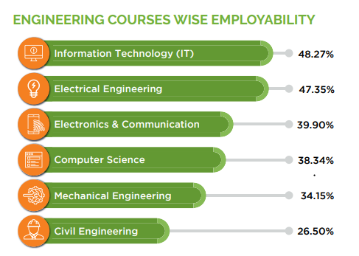
MOMENT OF TRUTH…
LOVELY PROFESSIONAL UNIVERSITY - DEPARTMENT OF SOFT SKILLS

Slide 4
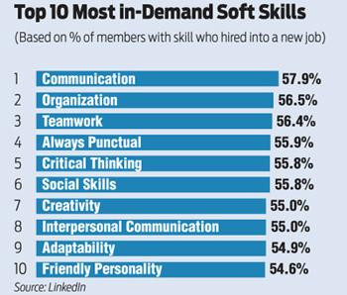
LOVELY PROFESSIONAL UNIVERSITY - DEPARTMENT OF SOFT SKILLS

Slide 5
Soft Skills… Why me?
Meaningful employment
Competitive advantage in today’s economy
“Technical Skills will get you the interview, but it’s the soft skills that get you the job”
LOVELY PROFESSIONAL UNIVERSITY - DEPARTMENT OF SOFT SKILLS

Slide 6

Soft Skills?
Connecting classrooms to Career….
LOVELY PROFESSIONAL UNIVERSITY - DEPARTMENT OF SOFT SKILLS

Slide 7

How are these classes different?
Student Centric Training
Interaction … Rule of 70:30
Imbibing Professionalism
Effective Body Language
Activities -Simulating Real Life Situation
Applying knowledge through Collaborative Learning
Use of Audio-Visual aids
Building confidence in Communication
Generating quest for Reading and Knowledge
LOVELY PROFESSIONAL UNIVERSITY - DEPARTMENT OF SOFT SKILLS

Slide 8

Our Expectations…
Dressing professionally for the classes
Wearing ID cards
Communication in English
Active participation in
Class activities
Club activities
Events
Reading newspaper
LOVELY PROFESSIONAL UNIVERSITY - DEPARTMENT OF SOFT SKILLS

Slide 9


Learning through Doing…
So are we ready??
LOVELY PROFESSIONAL UNIVERSITY - DEPARTMENT OF SOFT SKILLS

Slide 10
Overall Assessment
LTP- 1-2-0
Credits-3
Total- 100 marks
Academic task- 4(compulsory)
Academic Tasks- 30 marks each
No mid term examination
Attendance - 15 marks
End Term Practical- 55 Marks
Notes:
All AT’s are equally impoortant

Slide 11
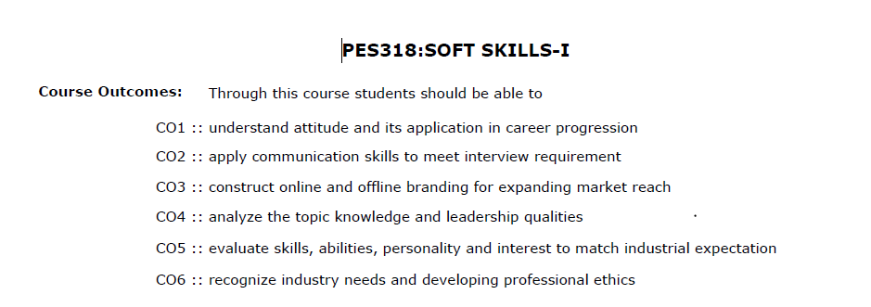
COURSE OUTCOMES PES 318

Slide 12
Continuous Assessment (CA)
CA1 – Presentation Individual 1 –SWOT Presentation
CA2 – Presentation Individual 2 – Elevator Pitch
CA3 – Group Discussion
CA4 - Interview

Slide 13
PES 318
Unit I Attitude Building : introduction to attitude, difference between attitude and behaviour, why is attitude important in an interview? personality traits an engineer should have, matching profession to your personality, introduction to different career pathways and swot analysis.
Unit II Building Communication Skills : oral communication and its importance in interview, active listening, engaging speaking skills, barriers to communication, non-verbal communication and its importance in interview, using paraverbal communication, introduction to virtual communication techniques.
Unit III Personal and Social Branding : introduction to self-branding, resume building, introduction to video CV and profiles, creating an impressive elevator pitch using USP's, introduction to various platforms of branding- LinkedIn, GitHub, using social media platforms constructively for branding.

Slide 14
PES 318
Unit IV Group Discussion : introduction to group discussions, idea generation techniques- SPELT, KWA, 5W 1H, brainstorming, POPBEANS, VAP, types of group discussion topics, picking the right strategy, do’s and don’ts of group discussion, types of group discussion.
Unit V Interview Skills : interview preparation, pre-interview preparation, interview kit, power dressing, know your company, interview etiquette in online and offline scenarios, types of interviews, answering techniques.
Unit VI Workplace Etiquette : introduction to professional ethics, teamwork, leadership, email etiquette, empathy and decision- making

Slide 15
Unit 1- Attitude Building

Slide 16
Impact during the interviews
• Observe body language
• Assess communication skills(Like Articulation of content, Interpersonal skills during coding )
• Check for enthusiasm
• Prepare a variety of questions
• Ask behavioural questions
Critical thinking ( Like in HM round, Hiring manager round)

Slide 17
SWOT
Strengths: Internal characteristics of a person give it an advantage over others.
Weaknesses: Internal characteristics of the person at a disadvantage relative to others.
Opportunities: Platforms/ elements in the environment that could exploit to its advantage.
Threats: Elements that can create trouble or issues.

Slide 18
SWOT Analysis
Company Profile (Infosys )
Strength
Weakness
Opportunity
Threat

Slide 19
Job role
Specialist Programmer (SP) An entry-level role in the Power Programmer stream at Infosys. Specialist Programmers are programming 'polyglots' who are experts in deep programming, full-stack capabilities, high complexity coding, developing rapid applications/platforms, and building technology-enabled solutions. The compensation for this role is
Digital Specialist Engineer (DSE) This role requires full stack capabilities and skills like analytics, artificial intelligence and automation, big data, cloud, cyber security, data consulting, and digital commerce, interaction, and marketing. Digital Specialist Engineers work across business units of Infosys on special projects to develop integrated applications and to bring agility in development with DevSecOps culture. The compensation for this role is

Slide 20
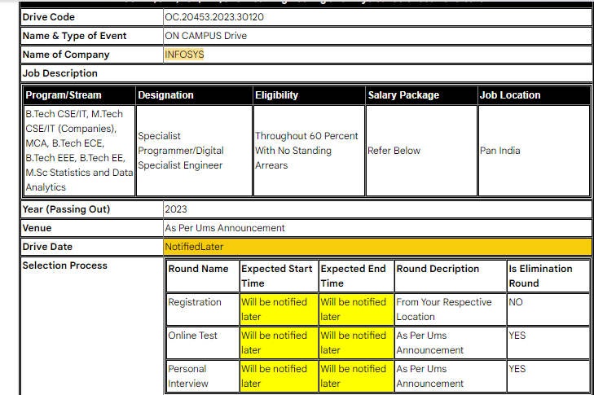
KYC

Slide 21
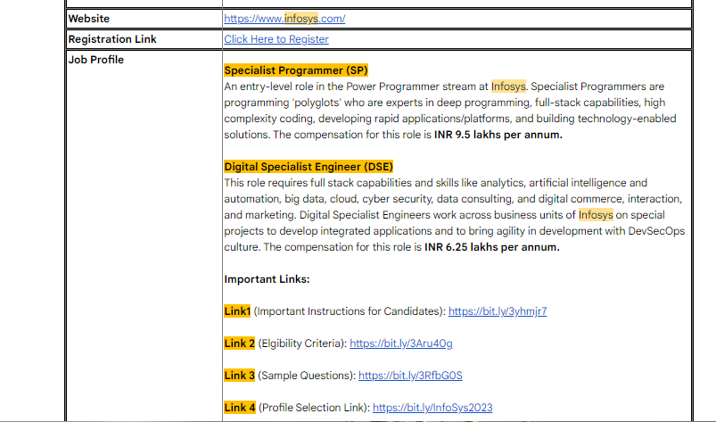
KYC

Slide 22
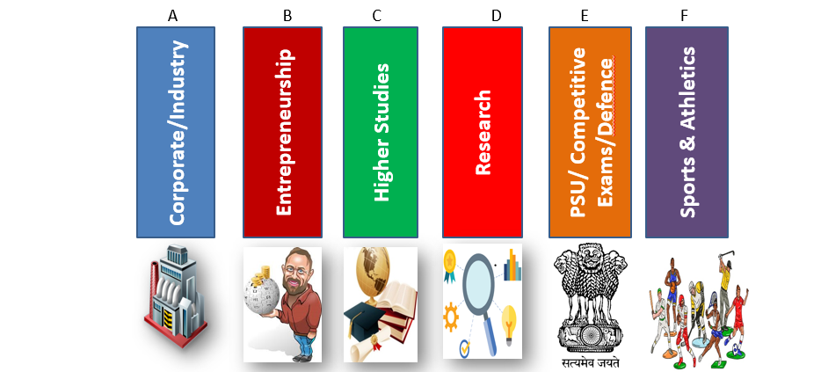
Career Pathway

